Slide 1
TicTacOhNo_{N}
Antonio Cardenas, Nathaniel Potrepka, Jonathan Liao

Slide 2
Initial Calculations
Simulating boards using Java
Exhaustive board generation up to n = 5
5,200,300 boards at n = 5
Exact probabilities for statistics calculated
Random board generation for larger n
Used 100,000 boards for tests
Tested up to n = 51

Slide 3
Key Findings
Tie percentage decreases slowly
Win probability for both players increases
Difference between UR and RIT approaches 0
Expected chain length increases linearly
Difference between a winning and tieing chain approaches ~2

Slide 4
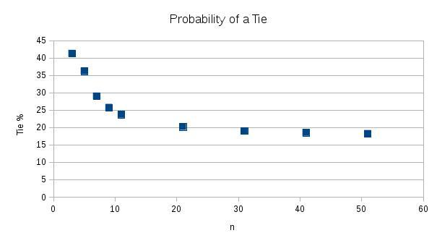
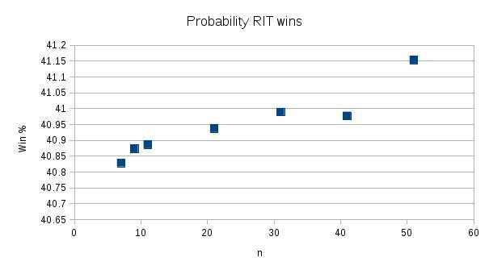
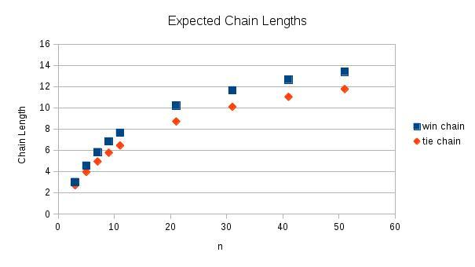
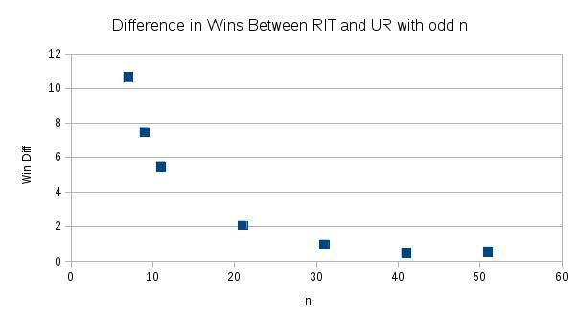

Slide 5
Future
Memory becomes an issue for n > 51
Possible to run multiple simulations of smaller sample sizes, but under 100,000 gives inconsistent results
Look more towards theory

Slide 6
Looking at chains of length N
Possible ways of getting an N-chain
Rows
Columns
Diagonals
Multiple overlaps

